Slide 1
Year 12 in 2025
Information for 2023 Year 10 Students and their Parents
2023/20339

Slide 2
Guide to key abbreviations
Abbreviation | Full term
ATAR | Australian Tertiary Admission Rank
OLNA | Online Literacy and Numeracy Assessment
SRMS | Student Records Management System
the Authority | School Curriculum and Standards Authority
TISC | Tertiary Institutions Service Centre
VET | Vocational Education and Training
WACE | Western Australian Certificate of Education
WASSA | Western Australian Statement of Student Achievement
WASN | Western Australian student number

Slide 3
The WASSA – All students
All students receive a Western Australian Statement of Student Achievement (WASSA) when they complete Year 12.
The WASSA:
formally records a student’s achievement in every course, qualification and program that the student has completed in senior secondary schooling
provides evidence of achievement.
Notes:
The WASSA is not the same as the Western Australian Certificate of Education (WACE).
As a record of student achievement, it lists as appropriate:
achievement of WACE requirements
achievement of literacy (reading and writing) standard
achievement of numeracy standard
achievement of exhibitions and awards
school grades, school marks, and combined scores in ATAR units
school grades and school marks in General and Foundation units
completed Preliminary units
completed VET industry specific units
successfully completed VET qualifications and VET units of competency
successfully completed endorsed programs
number of community service hours undertaken (if reported by the school).

Slide 4
The WACE
The Western Australian Certificate of Education (WACE) is awarded to students who have successfully completed senior secondary schooling in WACE studies and have met the WACE requirements.
The majority of students in Western Australia achieve the WACE.
Study towards the WACE can be undertaken over a lifetime.
Notes:
The WACE is recognised nationally by universities and other tertiary institutions, industry and training providers.

Slide 5
WACE requirements
Students must:
complete one of three course combination options
complete at least four Year 12 ATAR courses* OR
complete at least five Year 12 General courses and/or ATAR courses or equivalent OR
complete a Certificate II (or higher) VET qualification in combination with ATAR, General or Foundation courses
demonstrate the literacy and numeracy standards
meet the requirements for breadth and depth of study
meet the achievement standard.

Slide 6
Literacy and numeracy standard requirement
Students must demonstrate minimum standards of literacy and numeracy by either:
demonstrating the standard through the Online Literacy and Numeracy Assessment (OLNA); or
pre-qualifying in reading, writing and numeracy in their Year 9 NAPLAN and being exempted from that component in the OLNA.
Notes:
If students do not meet the literacy and numeracy standard by the time they exit secondary school, they can apply to the Authority to re-sit the assessment.
If students do not demonstrate the required standard, they will not be eligible for a WACE.
All students receive a Western Australian Statement of Student Achievement (WASSA), which records every course and program a student has completed in Years 11 and 12.
If students demonstrate the required minimum standard after they have left school, they will be awarded the WACE (assuming they have met all other WACE requirements).

Slide 7
Breadth and depth requirement
Students must complete a minimum of 20 units or the equivalent, including:
a minimum of ten Year 12 units or the equivalent
four units from an English learning area course, post-Year 10, including at least one pair of Year 12 units from an English learning area course
one pair of Year 12 units from List A
one pair of Year 12 units from List B.
Notes:
Students must complete a minimum of 20 units or the equivalent, including:
a minimum of ten Year 12 units or the equivalent
four units from an English learning area course, post-Year 10, including at least one pair of Year 12 units from an English learning area course (English, Literature, English as an Additional Language or Dialect)
one pair of Year 12 units from List A (arts/languages/social sciences)
one pair of Year 12 units from List B (mathematics/science/technology).
The breadth requirement can be met through ATAR, General and Foundation courses.
The depth requirement can be met through ATAR, General, VET industry specific and Foundation courses, VET credit transfer and endorsed programs.

Slide 8
Achievement standard requirement
Students must achieve 14 C grades or higher (or equivalents) in Year 11 and Year 12 units, including at least six C grades (or equivalents) in Year 12 units.
Notes:
Students must achieve 14 C grades (or equivalents) in Year 11 and Year 12 units, including at least six C grades in Year 12 units (or equivalents).
The achievement standard requirement can be met through ATAR, General, VET industry specific and Foundation courses.

Slide 9
Study options
Students are offered three study options which they can mix and match:
WACE courses (four course types – ATAR, General, Foundation and VET industry specific)
VET programs
endorsed programs.
Notes:
Students may accumulate results in WACE course units, endorsed programs and VET credit transfer over a lifetime.
WACE courses include: ATAR, General, Foundation and VET industry specific courses.
Eligible students may enrol in Preliminary units, but these are not WACE courses.
For students working towards the WACE over multiple years then the WACE requirements that apply to these students are determined by the WACE requirements in place for their final year of study.

Slide 10
Sample study programs – ATAR
Notes:
These sample programs provide examples of course combinations for different pathways to further study and training. They are not exhaustive.

Slide 11
Sample study programs – General
Notes:
These sample programs provide examples of course combinations for different pathways to further study and training. They are not exhaustive.

Slide 12
Sample study programs – Training
Notes:
These sample programs provide examples of course combinations for different pathways to further study and training. They are not exhaustive.

Slide 13
Australian Tertiary Admission Rank (ATAR) courses
These courses:
are examined by the School Curriculum and Standards Authority (the Authority)
are used by the Tertiary Institutions Service Centre (TISC) to calculate a student’s Australian Tertiary Admission Rank (ATAR).
There are written examinations for all ATAR courses.
There are practical examinations for some ATAR courses. Students must complete both examinations in these courses.
Notes:
These courses are examined by the Authority (see Section 6 of the WACE Manual).
Student results in ATAR courses are used by the Tertiary Institutions Service Centre (TISC) to calculate a student’s Australian Tertiary Admission Rank (ATAR).
The ATAR is used to determine eligibility for university entrance.
Students seeking to achieve an ATAR will need to complete a minimum of four Year 12 ATAR courses, excluding unacceptable combinations (see Undergraduate Admission Requirements for School Leavers on the TISC website).
ATAR courses are for students who are typically aiming to go to university.

Slide 14
Completing ATAR courses
Students enrolled in a Year 12 ATAR course pair of units are required to sit the written and, if the course has one, practical examination.
Students who do not sit the examination will not:
have a course mark or grade recorded on their WASSA
receive an ATAR course report
have the pair of units completed in that year contribute towards any of the WACE requirements.
Notes:
Students who are enrolled in a Year 12 ATAR course pair of units are required to sit the ATAR course examination— even if they are only enrolled in one ATAR course.
There are both written and practical examinations for some ATAR courses.
Students who do not sit an ATAR course examination and do not have an approved sickness/misadventure application for that course, will not have the grades for the pair of units completed in that year contribute to the calculation of the Western Australian Certificate of Education (WACE).
This means, the grades for the ATAR Year 12 course will not contribute to the:
completion of a minimum of 20 units, including 10 Year 12 units
completion of at least one pair of Year 12 units from an English learning area course (if the ATAR Year 12 course was either English, Literature or English as an Additional Language or Dialect)
completion of one pair of Year 12 units from List A (arts/languages/social sciences) or List B (mathematics/science/technology)
achievement of at least 14 C grades or higher, including at least six C grades in Year 12 units
completion of at least four Year 12 ATAR courses.
Students who do not sit the ATAR course examination will not have a course mark or grade recorded on their Western Australian Statement of Student Achievement (WASSA), nor will they receive an ATAR course report.
As a consequence, a student may not meet the requirements to receive a WACE.
The Authority advises consultation with students who may be enrolled in ATAR course/s but who do not require an ATAR, to confirm that they must sit the examination for that course for it to contribute to their WACE.

Slide 15
General courses
These courses:
are not externally examined
have an externally set task (EST) which is set by the Authority
are designed for students who are typically aiming to enter further vocationally based training or the workforce directly from school.
Notes:
General courses are for students who are typically aiming to enter further vocationally based training or the workforce straight from school.
General courses may be used for alternative entry to some university courses. Information about alternative entry should be sought directly from universities.

Slide 16
Online language enrolment applications
To enrol in a WACE language course, the Authority requires all students to complete an application for permission to enrol. Commencing in 2021, students will submit their language application in the student portal.
In their online language enrolment application, students will be assessed against three criteria:
Education
Residency and/or time spent in-country
Use of the language for communication outside the language classroom.
Notes:
The Authority requires all students intending to enrol in a WACE language course to complete an application for permission to enrol.
Traditionally, this application has been a paper form. Commencing in 2021, students will complete their WACE language course enrolment application in the student portal.
The objective of the language enrolment process is to ensure that students with a linguistic advantage in a language are not assessed against students who do not have the same advantage. Students deemed to have a greater linguistic competency than required by the course are not permitted to enrol in that course.
The criteria for enrolment have been designed to assess the degree to which a student has had previous experience in, and exposure to, the language they wish to study.
The school will endorse their students’ applications in the Student Records Management System (SRMS) portal, then the Authority will determine each student’s enrolment status.
Students will see their WACE language enrolment status in the student portal and schools can monitor the progress of applications in the SRMS.

Slide 17
Foundation courses
These courses:
focus on functional literacy and numeracy skills, practical work‐related experience and personal skills
are not an alternative senior secondary pathway
are for students who have not been able to demonstrate the minimum standard for literacy and/or numeracy before Year 11 and who require significant support
have an externally set task (EST) set by the Authority.
Notes:
These courses provide a focus on functional literacy and numeracy skills, practical work‐related experience and the opportunity to build personal skills that are important for life and work.
Foundation courses are not designed, nor intended, to be an alternative senior secondary pathway.
Foundation courses are for students who have not been able to demonstrate the minimum standard for literacy and/or numeracy (see sub-section 1.8 of the WACE Manual) before Year 11 and are unlikely to do so before the end of Year 12 without significant levels of support.
Like General courses, Foundation courses have an EST that is set by the Authority.
From 2021, students who enrol in Year 12 Foundation courses must complete a VET Certificate II (or higher) as part of the requirement to achieve a WACE.

Slide 18
VET industry specific courses
These courses:
include a full VET qualification and mandatory workplace learning
contribute towards the WACE as course units
qualifications undertaken through VET industry specific courses can be used to meet the Certificate II or higher component of the WACE
the workplace learning component of the course contributes as unit equivalents towards the WACE.
Notes:
VET industry specific courses include a full VET qualification and mandatory workplace learning. VET industry specific courses contribute towards the WACE as course units.
Qualifications undertaken through VET industry specific courses can be used to meet the Certificate II or higher requirement of the WACE. The workplace learning component of the course contributes as unit equivalents towards the WACE (see Section 4 of the WACE Manual for more detail).
VET industry specific courses are for students aiming to enter further vocationally based training or the workforce straight from school.
Some VET qualifications may be used for alternative entry to some university courses. Information about alternative entry should be sought directly from universities.

Slide 19
Preliminary courses
The Authority provides Preliminary courses for students who have been identified as having a:
learning difficulty and/or an intellectual disability, and
recognised disability under the Disability Discrimination Act 1992.
Preliminary courses do not contribute to the WACE, but a student doing Preliminary courses may also undertake studies that do contribute to the WACE.
Notes:
Note: Preliminary courses do not contribute to the achievement of a WACE.
Preliminary courses provide a relevant option for students who:
are unable to progress directly to training from school
require modified and/or independent education plans.

Slide 20
Vocational Education and Training (VET)
VET is nationally recognised and enables students to gain qualifications for all types of employment, and specific skills to help them in the workplace or in further training.

Slide 21
VET contribution to the WACE
As part of the minimum WACE requirements, a student may complete a Certificate II or higher in combination with ATAR, General or Foundation courses.
Studying VET can provide up to eight units towards the number of course units students need to complete to achieve their WACE.
Students will typically enrol in four or five additional ATAR, General or Foundation courses to meet the WACE requirements.
Students who do not enrol in at least four Year 12 ATAR courses or at least five Year 12 General courses and/or ATAR courses (i.e. their program of study includes one or more Foundation course/s in Year 12) must also complete a Certificate II or higher to achieve the WACE.

Slide 22
VET and the WACE

Slide 23
Endorsed programs
These programs:
provide access to areas of learning not covered by WACE courses or VET programs and contribute to the WACE as unit equivalents
are for students wishing to participate in programs that are delivered in a variety of settings by schools, workplaces, universities and community organisations.

Slide 24
Endorsed programs and the WACE
Endorsed programs can be used to:
contribute towards the depth requirement and the achievement standard requirement of the WACE
count as a maximum of four unit equivalents towards the WACE – two unit equivalents in Year 11 and two unit equivalents in Year 12.
The list of endorsed programs is available on the Authority website https://senior-secondary.scsa.wa.edu.au/syllabus-and-support-materials/endorsed-programs.
Notes:
Endorsed programs may replace up to two Year 11 course units and two Year 12 course units students need to achieve the WACE.
The list of endorsed programs is available on the Authority website https://senior-secondary.scsa.wa.edu.au/syllabus-and-support-materials/endorsed-programs.

Slide 25
Categories of endorsed programs
There are three categories of endorsed programs, which differ in respect to the developer, the type of evidence required for determining student achievement and the quality assurance process.
These categories are:
Authority-developed endorsed programs
Provider-developed endorsed programs
School-developed endorsed programs.
Notes:
Authority-developed endorsed programs
These endorsed programs are developed by the Authority to provide WACE recognition for students undertaking activities of a similar nature, and for which no quality-assured certificate or award is issued. Authority-developed endorsed programs may be offered by any school.
Evidence of the successful completion of Authority-developed endorsed programs is contained in a portfolio that is assessed by the school and subject to the Authority’s quality assurance processes.
Provider-developed endorsed programs
These endorsed programs are developed by a private provider, such as a university, community organisation or training institution. Provider-developed endorsed programs recognise structured learning programs that result in the attainment of a quality-assured certificate or award. Provider-developed endorsed programs are open to all schools.
Evidence of the successful completion of Provider-developed endorsed programs is the provider’s quality-assured certificate or award.
School-developed endorsed programs
These endorsed programs are developed by individual schools in response to a particular need and which cannot be met through a WACE course, a VET qualification or another endorsed program.
Evidence of the successful completion of School-developed endorsed programs is through school-based assessment that is subject to the Authority’s quality assurance processes.
Authority Developed Workplace Learning (ADWPL)
ADWPL is an Authority‐developed endorsed program that is managed by individual schools. To complete this program, a student works in one or more real workplace/s to develop a set of transferable workplace skills.
Students may accrue a maximum of two Year 11 units and two Year 12 units in Workplace Learning to contribute towards their WACE.

Slide 26
Changing courses in Years 11 and 12
The Authority publishes dates about changing enrolments in its Activities Schedule.
There are points in the semester after which students should not change courses because it would be unlikely they could complete the assessment program.
Notes:
The Activities Schedule is published on the Authority website.

Slide 27
Changing courses and withdrawing from courses
Changing means students replace one course enrolment with another.
Withdrawing means students are no longer studying a course.
If students withdraw from a course in Year 12, their enrolment course for the year is not recorded on their WASSA. This means no credit is given for the work done for the year’s units prior to dropping the course.

Slide 28
OLNA video
Notes:
A student who achieves Band 8 or higher in the reading, writing or numeracy component of the Year 9 NAPLAN, will be considered to have pre-qualified for that component.
The OLNA has three components – reading, writing and numeracy.
Students have five windows in each of Years 10, 11 and 12 to sit the OLNA. (Year 10 students have one additional window. This occurs in Term 4 of Year 9.)
It is compulsory for students to sit the numeracy, reading and/or writing components twice in Year 10 (if a students sits in the Year 9 Term 4 window this will count as their first Year 10 sit).
If students do not meet the standard in Year 10, then they must sit in Semester 1 of Year 11.
From then on, and if required, students may choose when next to sit the assessment. Students will have up to six opportunities before completing Year 12, to demonstrate the WACE minimum standard of literacy and numeracy.
Students will be required to satisfy both the reading and writing components in order to demonstrate the minimum WACE literacy standard.
Full details regarding the OLNA can be found at http://www.scsa.wa.edu.au/internet/Senior_Secondary/OLNA.
International and mature-age students are required to sit the test in either of the first two windows that is available to them. Students with disability who choose not to sit the assessment will not qualify for the WACE.
Support documents to assist teachers in preparing their students for assessment and for supporting those who have not demonstrated achievement at the minimum standard are available on the Authority website.

Slide 29
Literacy and numeracy standards
Meeting these standards:
is a benchmark of educational achievement
is valued by employers and post-school training providers
ensures all students leave school with the best chance of future success.

Slide 30
OLNA disability adjustments
Adjustments will be made to the OLNA conditions, if a student’s access to the assessment is significantly affected by a disability, impairment, illness or impediment.
Evidence of a disability, diagnosed by a specialised medical professional, is required for adjustment.
The Guidelines for equitable access for assessments is available on the Authority website at https://senior-secondary.scsa.wa.edu.au/assessment/disability-adjustment-guidelines.

Slide 31
OLNA — Typical adjustments
Adjustments typically requested for approval by principals include:
rest breaks and provision for a pause button
extra time to work
a reader
scribe assistance for the writing component
use of a support person for the reading and numeracy components
special formats.

Slide 32
Support — Literacy and numeracy standard
Assistance is available through:
Foundation courses designed for students who require significant support
feedback to schools on individual student performance for each OLNA component.
Students who have achieved the minimum standard of literacy and/or numeracy through the OLNA, are not eligible to enrol in Foundation courses.

Slide 33
The courses our school is offering
<<school to insert>>

Slide 34
The programs our school is offering
<<school to insert>>

Slide 35
WACE Checker
The WACE Checker is a tool that Year 12 students can use to check their progress towards meeting the requirements of the WACE.
It is designed to determine whether students have met (or are expected to meet) each of the requirements for the WACE.
The WACE Checker is easy to use.

Slide 36
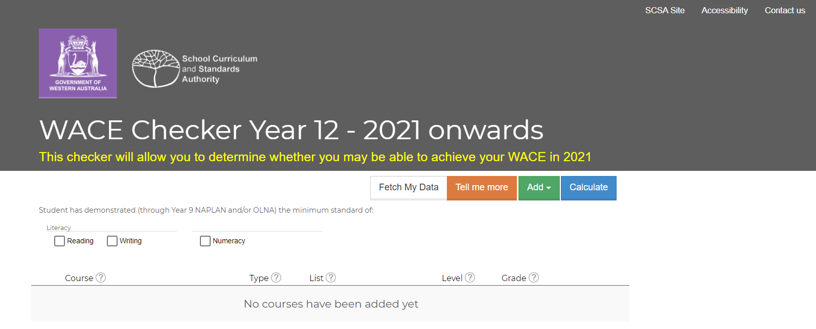
WACE Checker – Start Screen
Notes:
We encourage schools to share awareness of the tool with their Year 12 students.
Students can use it at home with their parents, or at school in conjunction with year coordinators or school admin staff if they are considering making changes to their education program.
There is a shared responsibility with the school and the student to ensure students remain WACE eligible should they make changes to the learning program and/or to monitor their grades.
Students enter information about their enrolments and achievements, the WACE Checker generates a report that shows progress towards WACE achievement.
Students can save the information, print it, email it to one or more people and if required, access the information at a later date to make changes.
For example, every year, students do not achieve their WACE because they don’t have a List B subject, or enough unit equivalents. This could be avoided by using the WACE Checker if students are seeking to make changes to their education program that may affect their WACE achievement.

Slide 37
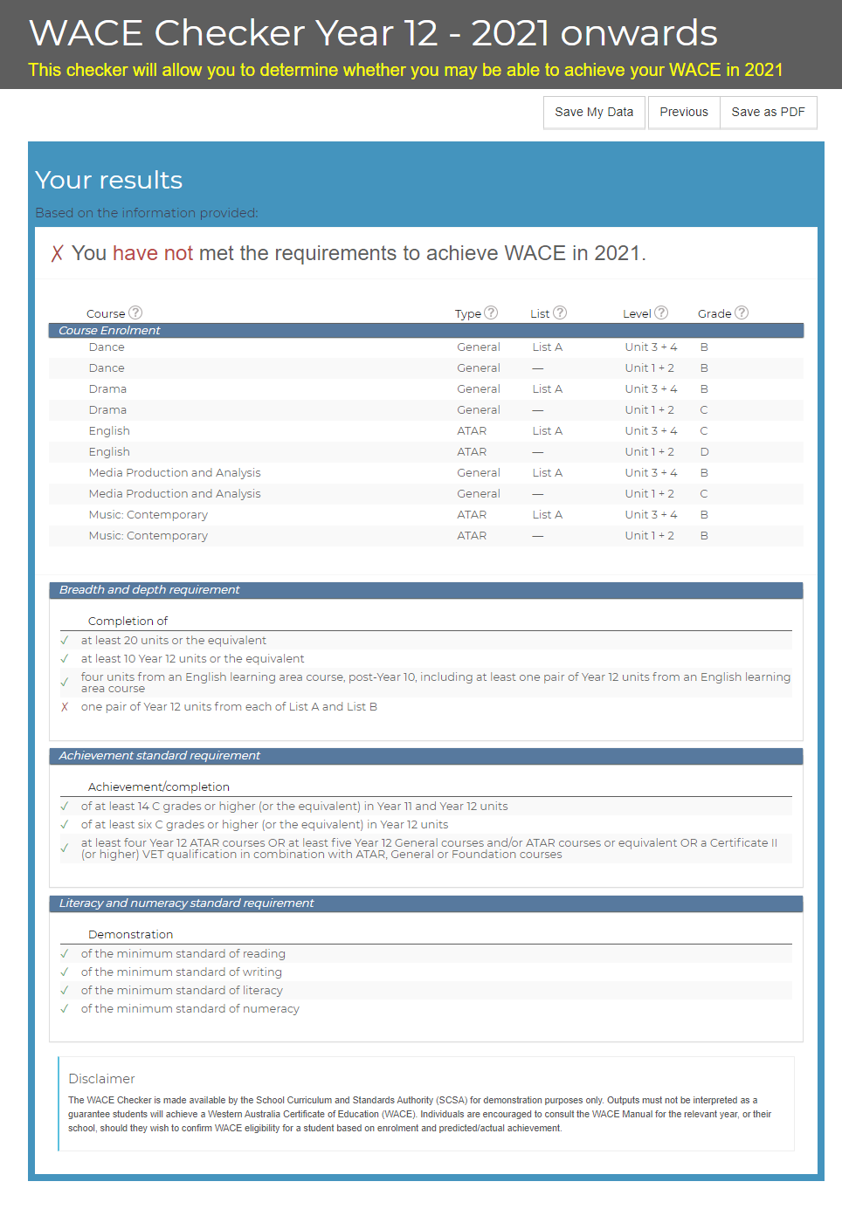
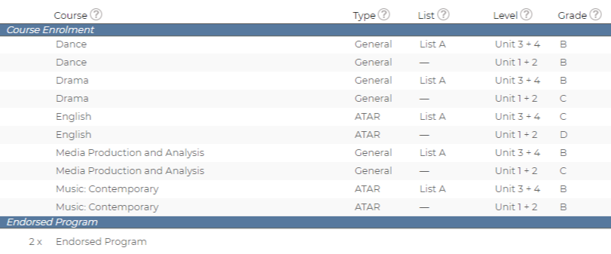
WACE Checker – Summary

Slide 38
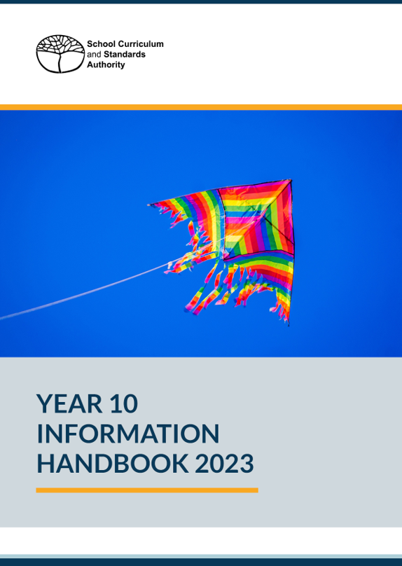
Information for students

Slide 39
Websites for students and parents
Notes:
Student Information website
The student site provides students with easy access to information under the headings of:
Student Portal
Getting Organised
Curriculum
Examinations and Texting
Certification and Post-School
Frequently Asked Questions (FAQs).
The student site currently focuses on Year 12s and links closely to the Year 12 Information Handbook 2020, Part I. The handbook is available at https://www.scsa.wa.edu.au/publications/year-12-information.
Parents and Community website
The Parent and Community website can now be accessed on the Authority website https://www.scsa.wa.edu.au via the Parents and Community tab.
The parent site provides information about what children and young people should learn, how they are assessed and the standards they are expected to reach at each year level, from Kindergarten to Year 12. The site will continue to be refined and developed over time.
The parent site has been developed for parents and community members as a guide to:
the Western Australian Curriculum and Assessment Outline (the Outline), Kindergarten through to Year 10
the Western Australian Certificate of Education (WACE), Years 11 and 12.
Parents and the community can access information about:
what children and young people should learn
how they are assessed
the standards children and young people are expected to reach at each year level.

Slide 40
Links
 | www.scsa.wa.edu.au
 | info@scsa.wa.edu.au
 | https://facebook.com/SCSAWA
e

Slide 41
© School Curriculum and Standards Authority, 2023
This document—apart from any third party copyright material contained in it—may be freely copied, or communicated on an intranet, for non-commercial purposes in educational institutions, provided that the School Curriculum and Standards Authority is acknowledged as the copyright owner, and that the Authority’s moral rights are not infringed.
Copying or communication for any other purpose can be done only within the terms of the Copyright Act 1968 or with prior written permission of the School Curriculum and Standards Authority. Copying or communication of any third party copyright material can be done only within the terms of the Copyright Act 1968 or with permission of the copyright owners.
Any content in this document that has been derived from the Australian Curriculum may be used under the terms of the Creative Commons Attribution-Non Commercial 4.0 Australia licence.
HPRM 2023/20339

